Slide 1

Slides for Chapter 15:
Coordination and Agreement
From Coulouris, Dollimore, Kindberg and Blair
Distributed Systems:
Concepts and Design
Edition 5, © Addison-Wesley 2012

Slide 2
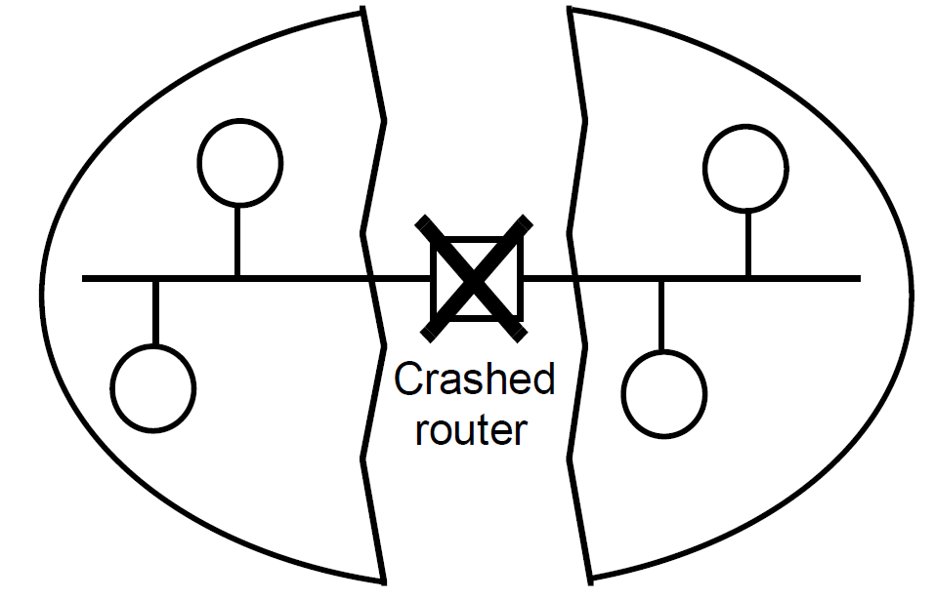
Figure 15.1
A network partition
Instructor’s Guide for Coulouris, Dollimore, Kindberg and Blair, Distributed Systems: Concepts and Design Edn. 5
© Pearson Education 2012

Slide 3
Figure 15.2
Server managing a mutual exclusion token for a set of processes
Server
Queue of
requests
4
2
3. Grant
token
1. Request
token
2. Release
p
p
token
4
1
p
p
2
3
Instructor’s Guide for Coulouris, Dollimore, Kindberg and Blair, Distributed Systems: Concepts and Design Edn. 5
© Pearson Education 2012

Slide 4
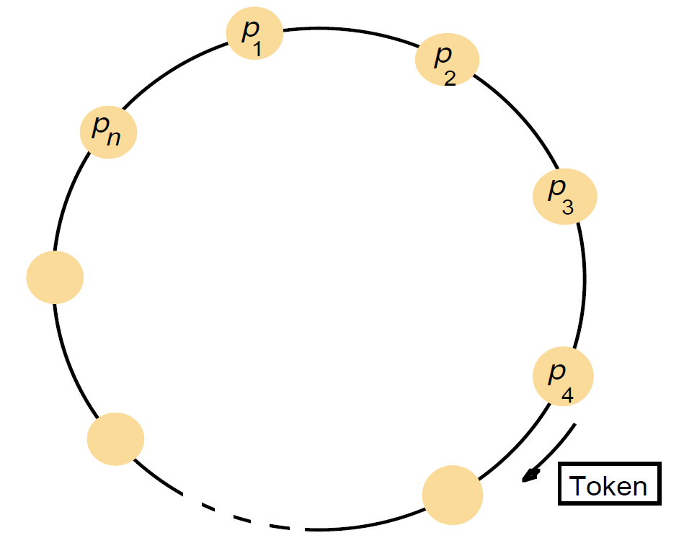
Figure 15.3
A ring of processes transferring a mutual exclusion token
Instructor’s Guide for Coulouris, Dollimore, Kindberg and Blair, Distributed Systems: Concepts and Design Edn. 5
© Pearson Education 2012

Slide 5
Figure 15.4
Ricart and Agrawala’s algorithm
On initialization
state := RELEASED;
To enter the section
state := WANTED;
Multicast request to all processes; request processing deferred here
T := request’s timestamp;
Wait until (number of replies received = (N – 1));
state := HELD;
On receipt of a request <T_{i}, p_{i}> at p_{j} (i ≠ j)
if (state = HELD or (state = WANTED and (T, p_{j}) < (T_{i}, p_{i})))
then
queue request from p_{i} without replying;
else
reply immediately to p_{i};
end if
To exit the critical section
state := RELEASED;
reply to any queued requests;
Instructor’s Guide for Coulouris, Dollimore, Kindberg and Blair, Distributed Systems: Concepts and Design Edn. 5
© Pearson Education 2012

Slide 6
Figure 15.5
Multicast synchronization
41
41
p
3
p
1
Reply
Reply
34
Reply
34
41
p
34
2
Instructor’s Guide for Coulouris, Dollimore, Kindberg and Blair, Distributed Systems: Concepts and Design Edn. 5
© Pearson Education 2012

Slide 7
Figure 15.6
Maekawa’s algorithm – part 1
On initialization
state := RELEASED;
voted := FALSE;
For p_{i} to enter the critical section
state := WANTED;
Multicast request to all processes in V_{i};
Wait until (number of replies received = K);
state := HELD;
On receipt of a request from p_{i} at p_{j}
if (state = HELD or voted = TRUE)
then
queue request from p_{i} without replying;
else
send reply to p_{i};
voted := TRUE;
end if
For p_{i} to exit the critical section
state := RELEASED;
Multicast release to all processes in V_{i};
On receipt of a release from p_{i} at p_{j}
if (queue of requests is non-empty)
then
remove head of queue – from p_{k}, say;
send reply to p_{k};
voted := TRUE;
else
voted := FALSE;
end if
Instructor’s Guide for Coulouris, Dollimore, Kindberg and Blair, Distributed Systems: Concepts and Design Edn. 5
© Pearson Education 2012

Slide 8
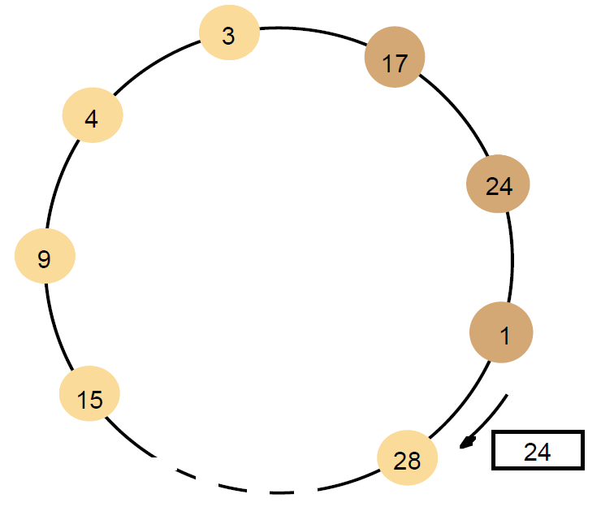
Figure 15.7
A ring-based election in progress
Note: The election was started by process 17.
The highest process identifier encountered so far is 24.
Participant processes are shown in a darker colour
Instructor’s Guide for Coulouris, Dollimore, Kindberg and Blair, Distributed Systems: Concepts and Design Edn. 5
© Pearson Education 2012

Slide 9
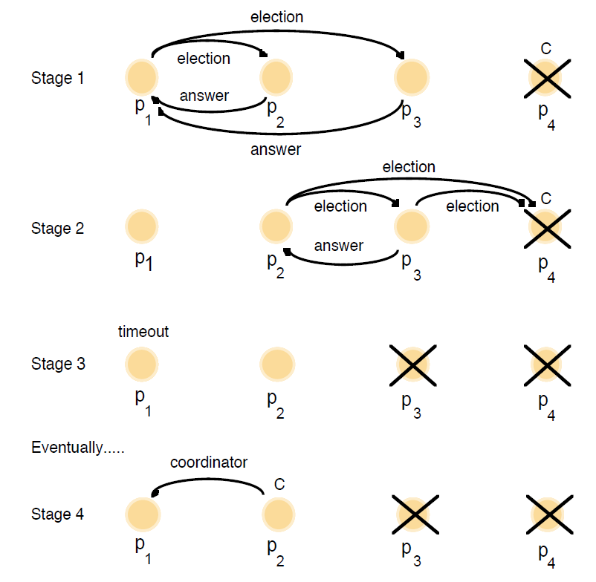
Figure 15.8
The bully algorithm
The election of coordinator p₂,
after the failure of p₄ and then p₃
Instructor’s Guide for Coulouris, Dollimore, Kindberg and Blair, Distributed Systems: Concepts and Design Edn. 5
© Pearson Education 2012

Slide 10
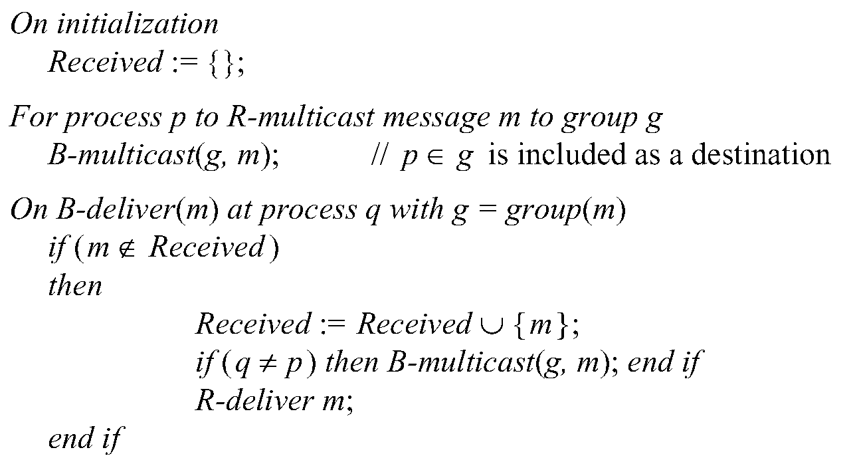
Figure 15.9
Reliable multicast algorithm
Instructor’s Guide for Coulouris, Dollimore, Kindberg and Blair, Distributed Systems: Concepts and Design Edn. 5
© Pearson Education 2012

Slide 11
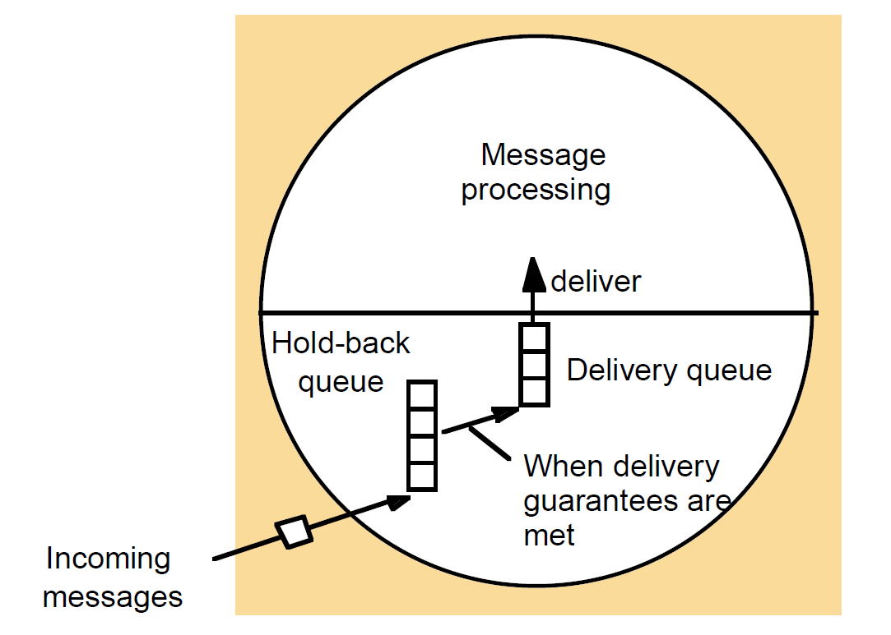
Figure 15.10
The hold-back queue for arriving multicast messages
Instructor’s Guide for Coulouris, Dollimore, Kindberg and Blair, Distributed Systems: Concepts and Design Edn. 5
© Pearson Education 2012

Slide 12
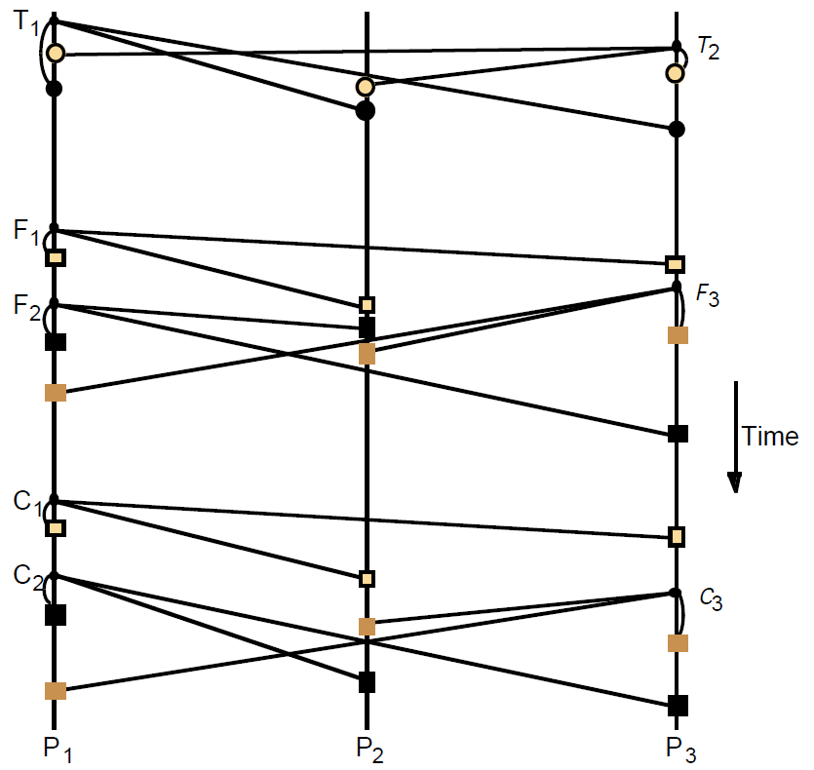
Figure 15.11
Total, FIFO and causal ordering of multicast messages
Notice the consistent ordering of totally ordered messages T₁ and T₂,
the FIFO-related messages F₁ and F₂ and the causally related messages C₁ and C₃
– and the otherwise arbitrary delivery ordering of messages.
Instructor’s Guide for Coulouris, Dollimore, Kindberg and Blair, Distributed Systems: Concepts and Design Edn. 5
© Pearson Education 2012

Slide 13
Figure 15.12
Display from bulletin board program
Bulletin board:
os.interesting
Item
From
Subject
23
A.Hanlon
Mach
24
G.Joseph
Microkernels
25
A.Hanlon
Re: Microkernels
26
T.L’Heureux
RPC performance
27
M.Walker
Re: Mach
end
Instructor’s Guide for Coulouris, Dollimore, Kindberg and Blair, Distributed Systems: Concepts and Design Edn. 5
© Pearson Education 2012

Slide 14
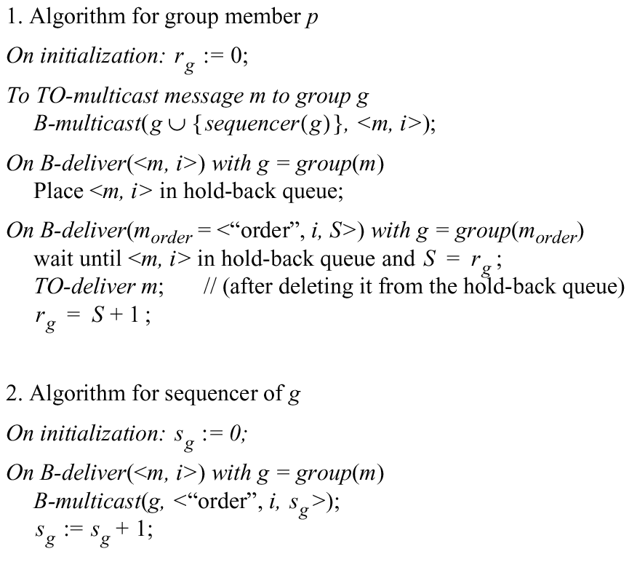
Figure 15.13
Total ordering using a sequencer
Instructor’s Guide for Coulouris, Dollimore, Kindberg and Blair, Distributed Systems: Concepts and Design Edn. 5
© Pearson Education 2012

Slide 15
Figure 15.14
The ISIS algorithm for total ordering
P
2
1 Message
3
2
P
2
2 Proposed Seq
4
1
3 Agreed Seq
1
2
P
1
3
P
3
Instructor’s Guide for Coulouris, Dollimore, Kindberg and Blair, Distributed Systems: Concepts and Design Edn. 5
© Pearson Education 2012

